Slide 1
Challenge Your track
Cult of Pa2nality

Slide 2
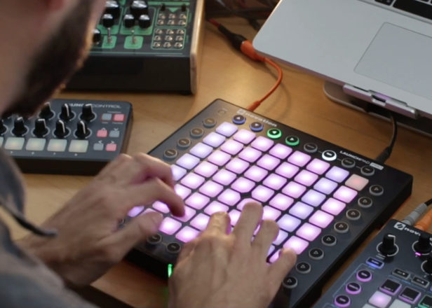
About market
The market of music launchpads is filled with mostly expensive and inaccessible models.

Slide 3
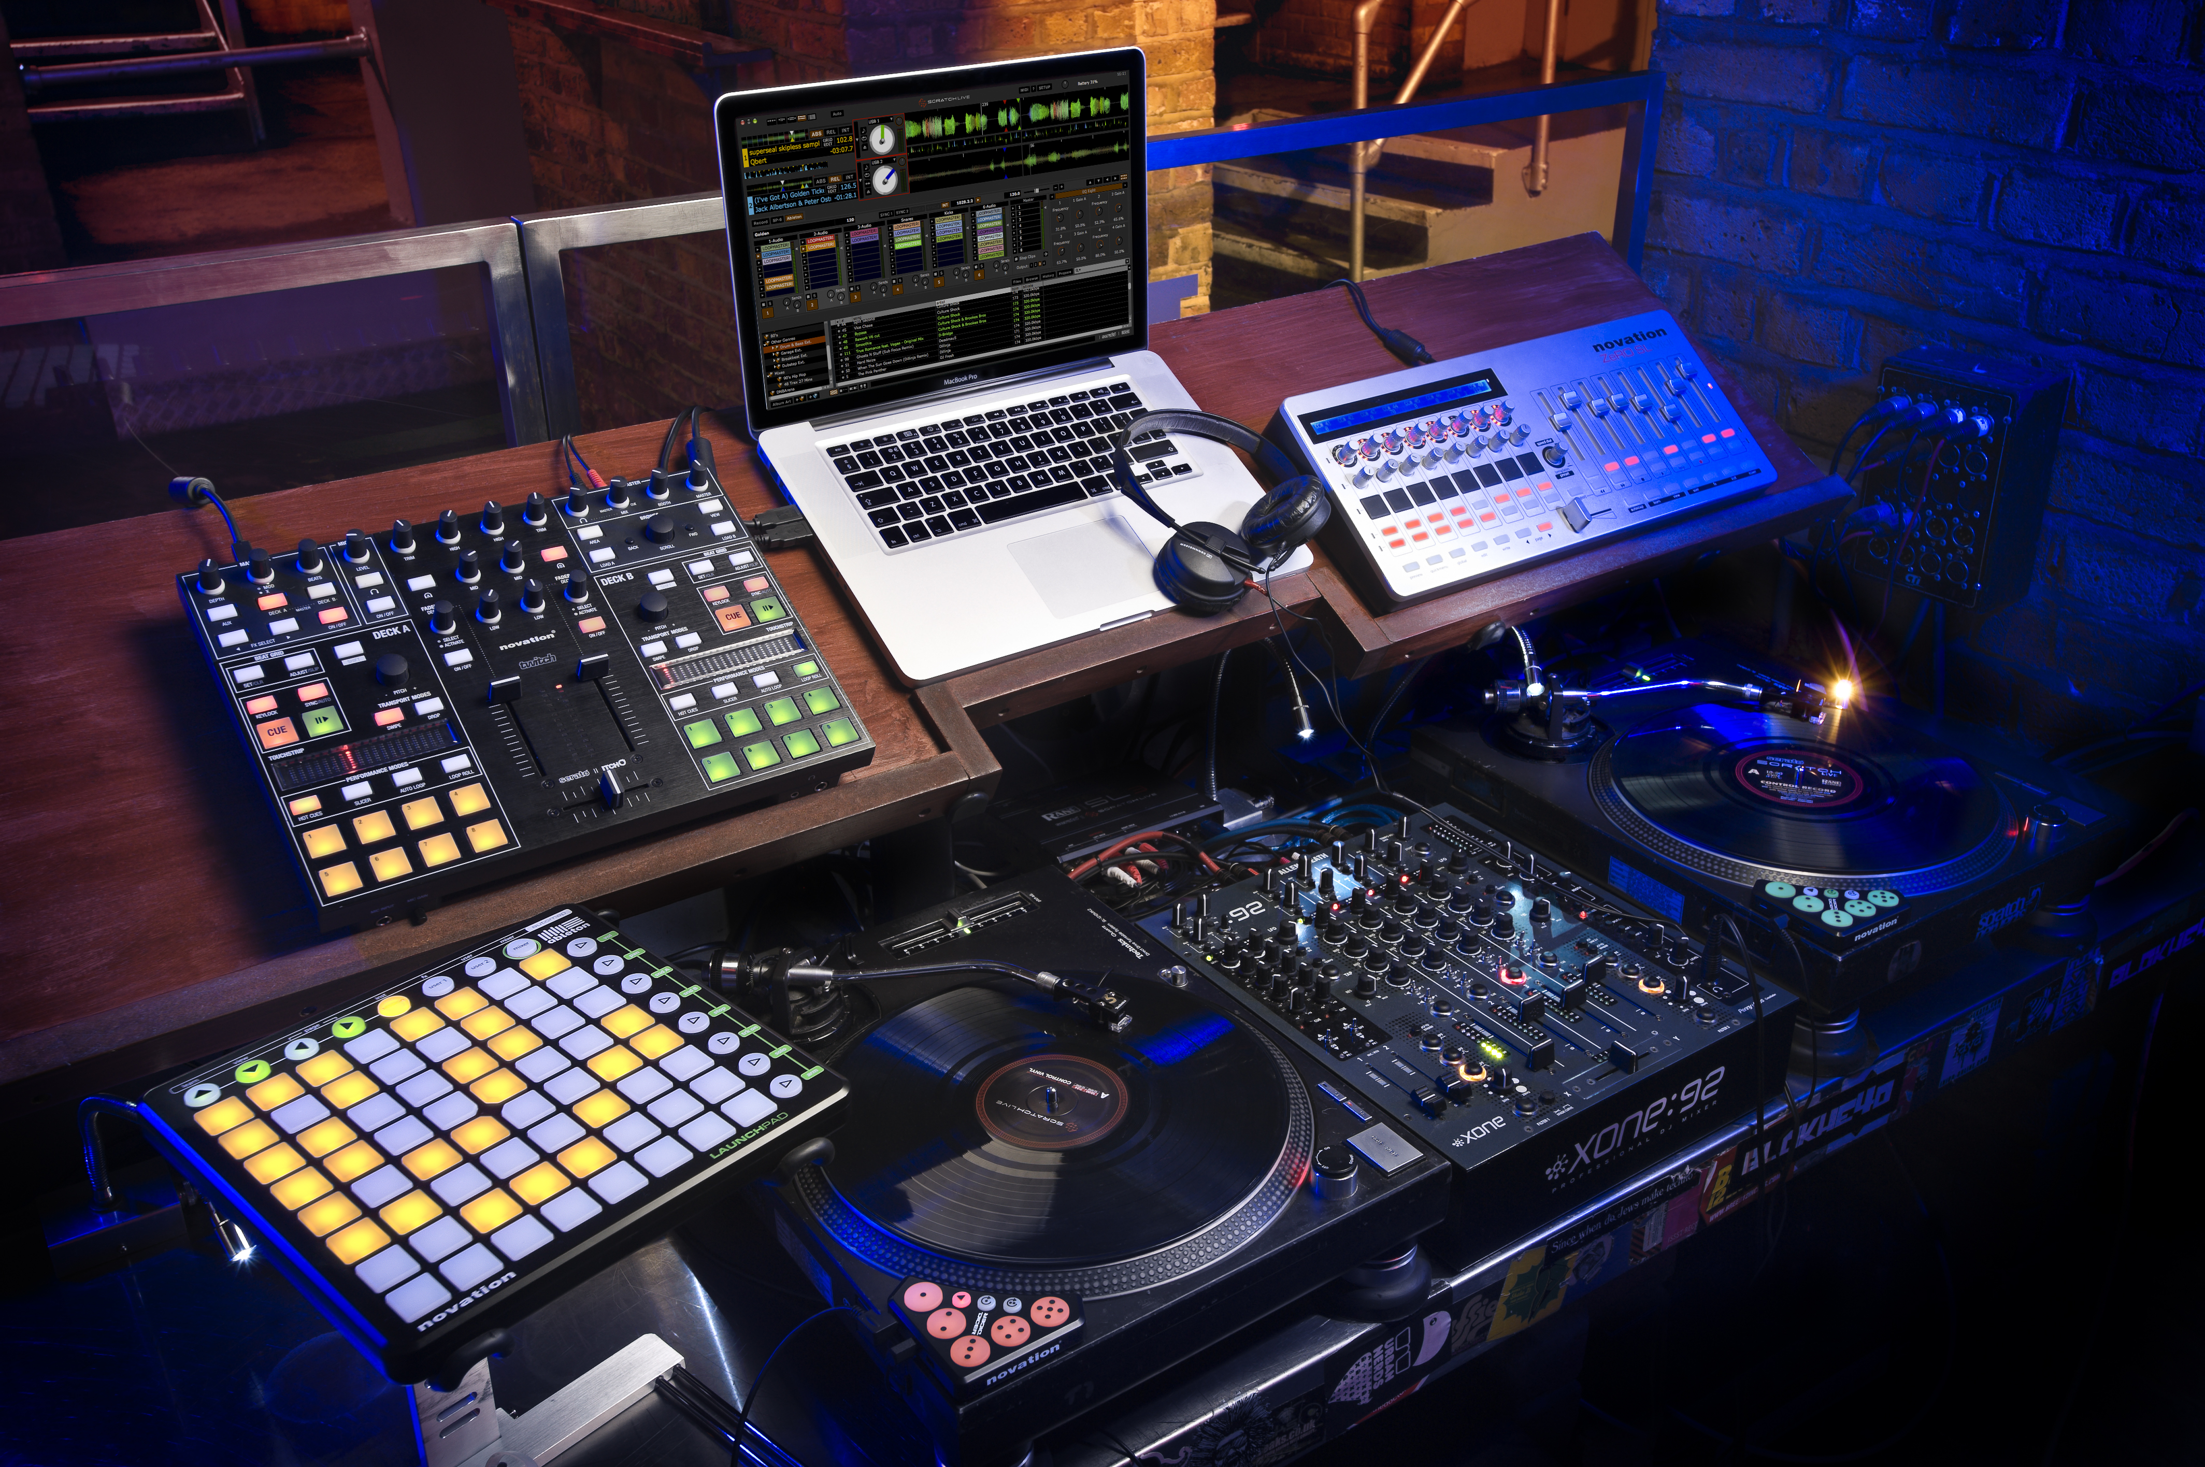
Our Solution
But we offer a launchpad at a much lower price.

Slide 4

Architecture
We used openCV in this project

Slide 5
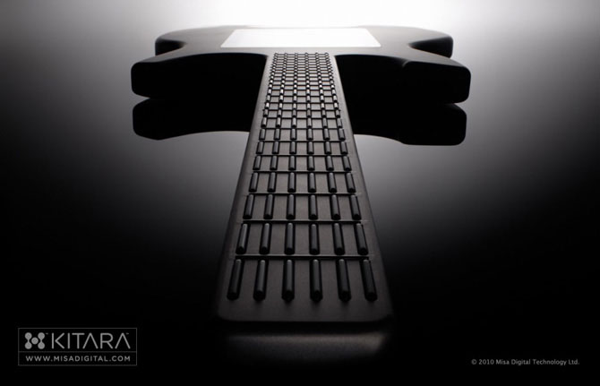
Future plans
We want to release other non-contact musical instruments. Just imagine an electric guitar without strings

Slide 6
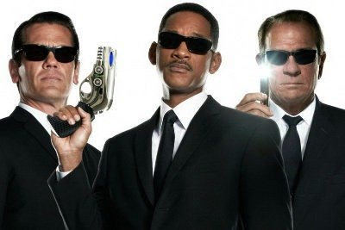
TEAM
Alexander Semeniuk
Emil Sataev
Arseniy Zhil`tsov

